Slide 1
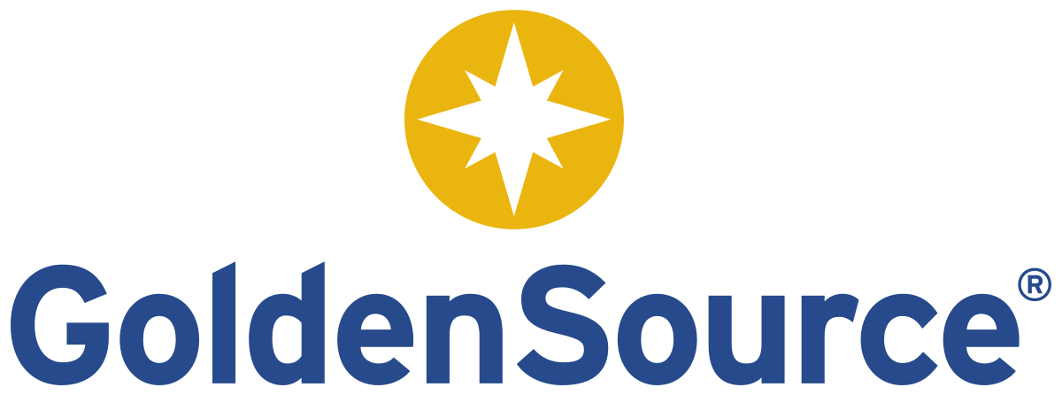
One for All: Leveraging Cloud in Client, Account Product Data Management
A conversation with
Jeremy Katzeff
CFA, Head of Buy Side Solutions
GoldenSource
Kulveer Cheema
PreSales Lead, Americas
GoldenSource

Slide 2
Moderated by Mike Meriton
Co-Founder, EDM Council
Joined EDM Council Full-time 2015 to Lead Industry Engagement
EDM Council Co-Founder & First Chairman (2005-2007)
EDM Council Finance Board Chair (2007-2015)
Former CEO, GoldenSource (2002-2015)
Former Executive, D&B Software and Oracle
FinTech Innovation Lab – Executive Mentor (2011 – Present)
EDM Council COO (2020-2023)

Slide 3
Today’s Panel
Moderator
Mike Meriton
Co-Founder
EDM Council
Jeremy Katzeff
CFA, Head of Buy Side Solutions
GoldenSource
Kulveer Cheema
PreSales Lead, Americas
GoldenSource

Slide 4
Agenda
1
The Challenge
2
Traditional ways to solve the problem and their limitations
3
Innovative ways to solve the problem
Illustration of the new approach (case studies, results, proof points) and the business value delivered
4
5
How to prepare for this new approach, lessons learned, business results
6
How to learn more

Slide 5
The Challenge

Slide 6
What is CAP Data?
Client, Account, and Product Data
Client Distribution and who is buying these products
Account Where products are held
Product Investment instruments, vehicles, marketable things firms develop and sell to clients

Slide 7
What is the industry problem?
Data is mostly managed offline in proprietary processes
Across different, siloed teams
There’s a need to break down those siloes and manage the data uniformly
Operating on legacy, on-premise technology

Slide 8
What are the business/operational effects?
Increased operational and regulatory risk
Slows down product management and launch process
Incorrect fee calculations
Significantly increased time to value from the cloud

Slide 9
Poll #1
How are you currently managing client, account, and product data?
Managing them all separately
Managing all three together
Client and Product together
Client and Account together
Product and Account together
Not managing them at all

Slide 10
Traditional Solutions

Slide 11
How have firms solved for this in the past?
Offline, ad-hoc processes
Email, spreadsheets, faxes
Manual updates to data management systems
Writing script directly to the database
Siloed teams addressing domains individually
How has this solved the problem?
Ad-hoc processes were purpose built for those individual problems
Teams each developed their own ways to address the need
Caused broader problems…

Slide 12
Traditional CAP Data Management Challenges
Could not scale
No audit trail, lineage, or governance
No cohesion among and between teams
No standardization and error-prone
Analytics in the cloud – ill-equipped for regulatory reporting and time-series analysis
Lose out on substantial value from mastered data

Slide 13
The Future is Now

Slide 14
Poll #2
What is the biggest pain point you are currently experiencing with CAP data?
Establishing definitions and interlinking client, account, and product data
Publishing client reports, analytics, factsheets, and reg reporting
Integrating with onboarding, CRM, accounting, and KYC systems
Handling and managing sensitive CAP data
Single version of truth and deduplication

Slide 15
The New Way to Solve CAP Data Management Problems
Centralize the process
Bring together key stakeholders to collaborate and certify
Establish a defined workflow to create and manage the product lifecycle
Utilize the power of the cloud

Slide 16
Case Study Top 10 Fund Company
Products
Client Profile
Top 10 Fund Company
Product master and client master currently in use
Data Model
Entity Master
Customer Master
Product Master
Business Problem
Cloud-Based Product Solution
Benefits Realized
No central product master – source of truth for product information existed in Excel spreadsheets and/or Word documents
Multiple sources without a central repository made data scattered and unreliable
No data audit capabilities
Operational inefficiency when launching new products and servicing clients
All identifiers, attributes, and metadata required to launch a product housed in one controlled, centralized database
High quality, validated and managed data accessible to both people and systems who need it
Effective cross-functional governance, data management, and data quality processes to ensure accuracy, consistency, timeliness, and integrity of data assets
Reduction of regulatory risk, operational siloes, and inconsistencies in master data
Reduced duplication of meta data management
Reduced complexity, cost, and time-to-access and use data assets
Efficient integration and consumption of master data assets
Enhanced time-to-market and client satisfaction
Anticipated 50% reduction in internal effort-to-market for new product launches*
*Internal estimates based on experience with projects of a similar scope. Results may vary.

Slide 17
Case Study Mutual Fund
Products
Client Profile
Privately owned investment management firm with over $175 billion in assets under management.
Product Master
Account Master
Business Problem
Cloud-Based Product Solution
Benefits Realized
Legacy applications-built decades ago do not support new product launches and enhancements
No data governance
Decentralized product reference data, everyone managing their own systems with manual updates leading to challenges in reporting
Challenge in distributing data to websites, marketing materials, factsheets, BI and client reporting
Centralized data management platform to create, maintain life cycle of institutional & retail accounts
Data quality and cleansing rules applied as part of account onboarding processes
Ability to have a centralized view of product and account linkages using GoldenSource highly comprehensive data model
Integration with SQS and SNS to notify downstream consumers
Integration with Salesforce to publish account and product data sets
Centralized data hub for enterprise product reference data
Systematic approach for onboarding new products and data
Established data governance, data lineage, data dictionary
Empower business users for self service
Set foundation to retire legacy applications
Scalable and robust solution enabling operational efficiencies and automation
Net operating cost decreased

Slide 18
Case Study Asset Management Division of a large Insurer
Products
Client Profile
Asset manager within an insurance company
Advisory, fund accounting and administration for parent company’s variable products and employee 401(k) retirement plan
Data Model
OnDemand
Security Master
Connections & Adaptors
Data
Warehouse
Business Problem
Cloud-Based Product Solution
Benefits Realized
Scale to support future regulatory reporting needs, including N-PORT report modernization reforms
Unable to support requirements to ingest reference data from additional, “best of breed” data sources
Operational team no longer willing to maintain an on-premise platform
Data Warehouse and Security Master to replace legacy data management platform
Integration with the current accounting system (FIS) enriched reference data from additional data sources
Generated N-PORT reports from Data Warehouse that were able to feed the company’s reporting system
Enabled data quality and integrity checks between the company’s accounting system and multiple data vendors
Lightweight operating model provided flexibility and speed in onboarding additional data vendors
Allowed for end user control of N-PORT report generation

Slide 19
The Results
Allows firms to be more data aware
Institutional workflow enables scalability
Accelerates time to market for new fund launches

Slide 20
Looking Forward

Slide 21
Lessons Learned
Solution has to be scalable and user-driven
Business-oriented functionality
Let people collaborate
Not everyone wants to leverage cutting edge

Slide 22
Things to Think About
The move to cloud isn’t a straight line
Involve the correct stakeholders along the journey
Think about the future state, not just the immediate objective

Slide 23
Questions?

Slide 24
Learning More

Slide 25
Who We Are
Visit us at www.thegoldensource.com
To learn more, reach out to info@thegoldensource.com
The largest independent provider of Enterprise & Master Data Management (E-/MDM) software and cloud data management services
Data vendor neutral — over 100 data partners
Founding and active member of the EDM Council
PaaS oriented, fit-for-purpose solutions`
Rich domain IP built over 40 years of exclusive focus on financial services data management
Headquartered in NYC with 400+ employees globally (London, Milan, Australia, Singapore, Mumbai)
Cloud enabled (AWS / Azure / private)
6
Offices in 6 countries
50
Over 50 Customers
400
More than 400 Team Members
$1.5bn AUM
Owned by Gemspring Capital

Slide 26
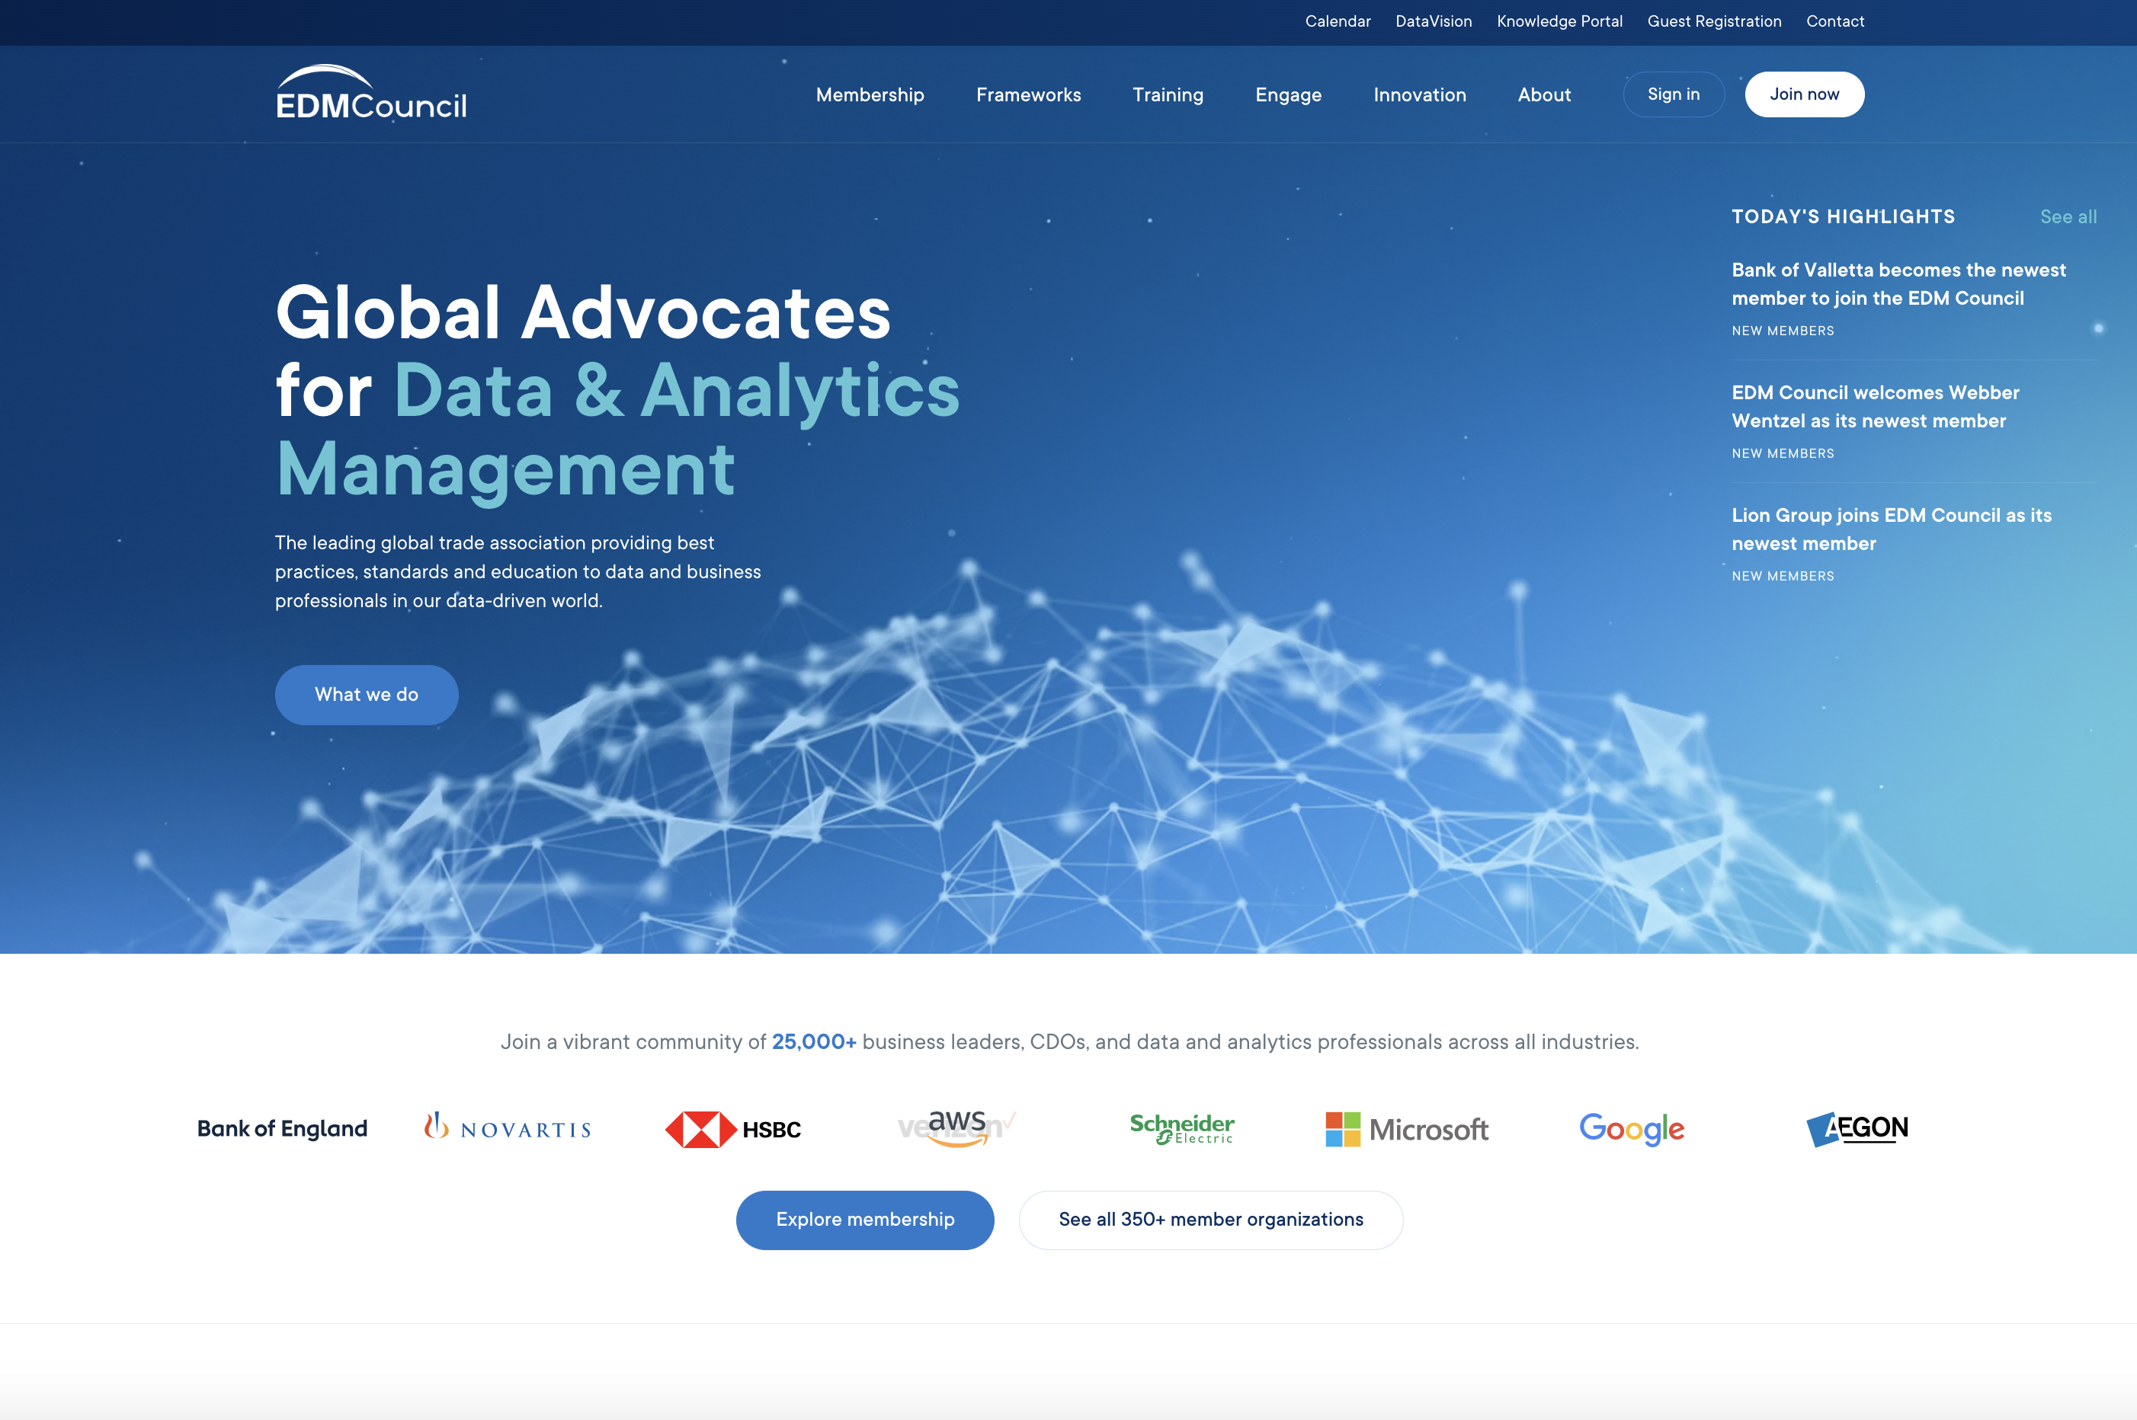
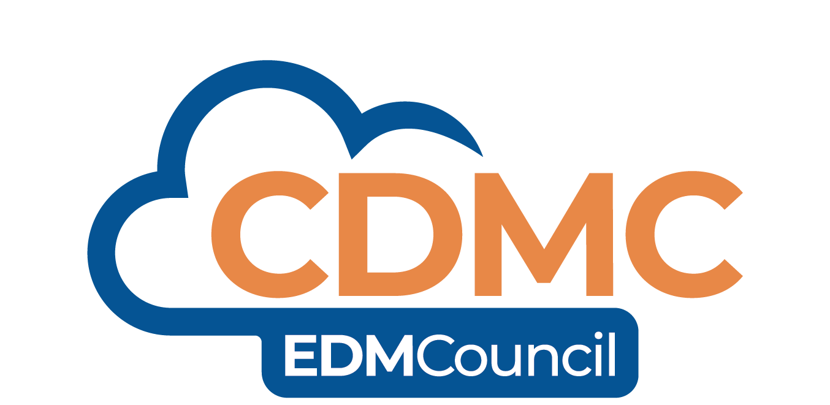
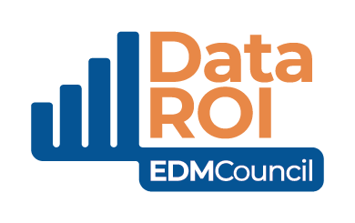
Join EDM Council and our membership
community of companies…
350+ Member Firms Cross-industry, including Regulators
25,000+
Professionals
Worldwide
Americas, Europe, Africa, Asia, Australia
edmcouncil.org

Slide 27
Thank You!

